Slide 1

Demo presentation
Week 4
Matyas molnar
Github : green-fox-academy/matyoo111

Slide 2
Content of presentation
Introduction
ToDoApp original
ToDoApp refactored
Conclusion

Slide 3




Introduction
Mathematics and Philosophy at the University of York
Water polo
Philosophy of Science at the London School of Economics
Lifeguarding
Business Developer at FriendlyScore
FinTech Research Analyst Inter at McKinsey and Company

Slide 4
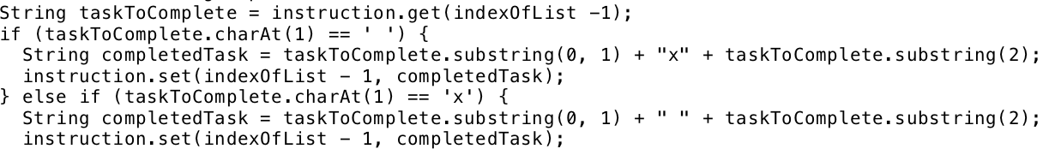
ToDoapp (original)
Create a ToDoApp with the following features:
List items
Add task
Remove task
Mark task as complete

Slide 5
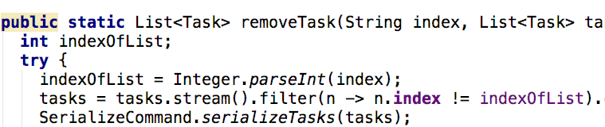
Todoapp (refactored)
Classes and objects used for tasks and instructions such as
Tasks
Instructions
Key instructions
Serialize to save objects into files and read them
Streams for easier list-handling

Slide 6
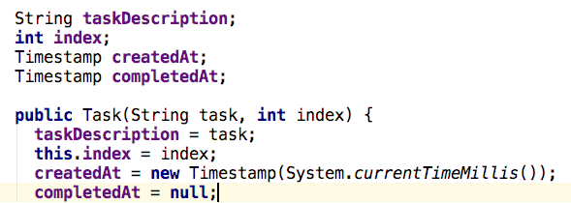
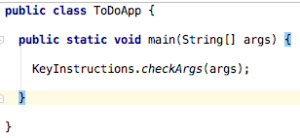
Todoapp (refactored)

Slide 7
Error handling
IndexOutOfBoundException
NumberFormatException
ConcurrentModificationException
Tried to read and write a file in many different places while running the program
Solved by rearranging reading and writing file to the beginning and the end of the running program, thereby preventing it from causing error

Slide 8
Conclusion
Object orientation helps to logically structure the program and understand it
I could not understand my own structure at the beginning of rearrangement
Error handling in advance
Streams can save a lot of unnecessary typing and running time

Slide 9
Thank you for watching!
Matyas molnar
Github : green-fox-academy/matyoo111
Linkedin : https://www.linkedin.com/in/molnarmatyas/

